Slide 1
Blockchain Solution to Healthcare Record System
BY – MREDULA NAIR
BATCH - S4 B

Slide 2
INTRODUCTION OF BLOCKCHAIN
The blockchain was popularized by a person (or group of people) using the name Satoshi Nakamoto in 2008.
Blockchain technology is a structure that stores transactional records, also known as the block, of the public in several databases, known as the “chain,” in a network connected through peer-to-peer nodes. Typically, this storage is referred to as a ‘digital ledger.’
Every transaction in this ledger is authorized by the digital signature of the owner, which authenticates the transaction and safeguards it from tampering. Hence, the information the digital ledger contains is highly secure.

Slide 3
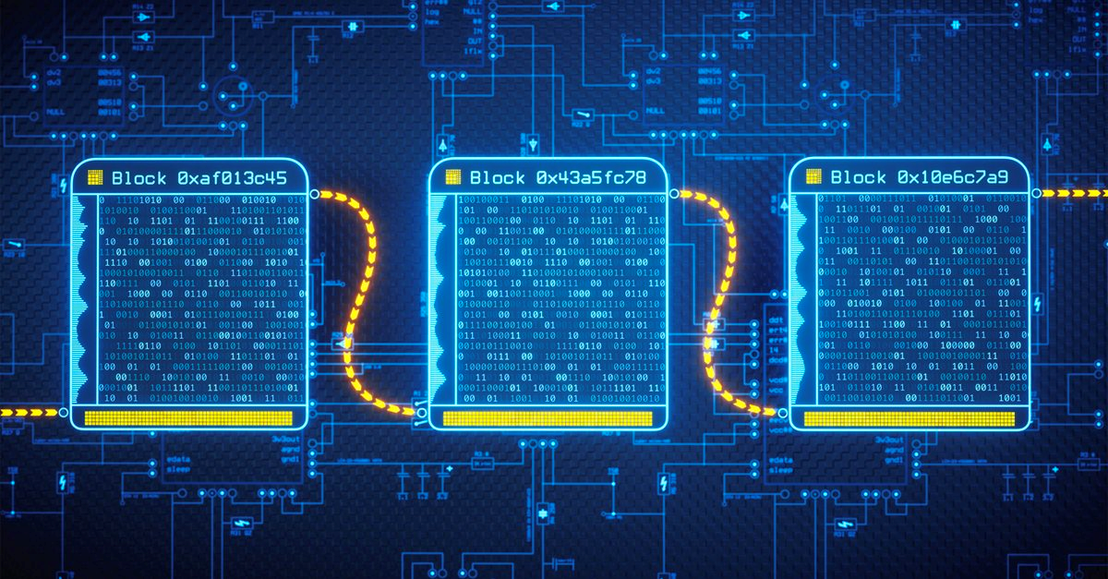
Blockchain

Slide 4
PROJECT-Blockchain Solution to Healthcare Record System Introduction
An EHR is an electronic version of a patient’s medical details. In current times, EHR is used to share patients’ medical records across various hospitals. EHR consists of health information of the patient in the form of Electronic Medical Record (EMR). EMR contains a patient’s medical diagnoses, allergies, history, treatment, and laboratory reports.
. Blockchain provides a secure distributed database and queries to the database can be made without any intervention of unauthorized identities. It is highly efficient in the case when various participants want to access the same database. Thus, blockchain can minimize a lot of resources and costs to access the same database securely.

Slide 5
The critical issue in the electronic health/medical records (EHR/EMR) is maintaining the interoperability among various involved identities. This issue may cause obstacles in the data transaction among each other. There is a lack of data management and sharing mechanism among the identities which leads to fragmentation of the healthcare information. Apart from interoperability, data security and privacy are also challenges in the current ways of data storing and sharing data through EHR/EMR systems.

Slide 6
Solution to this problem
All hospitals act as organizations in fabric network. Patient data has been treated as assets which is stored in the ledger. For now patient record has few fields like personal and medical details like age, address, allergies, symptoms, treatment, followup, etc.
When doctor is medicating to a patient, patient history data will be available which helps doctors to assign appropriate treatment. To improve the privacy of records, it is designed to provide extra steps in application for patients. Patient can decide to have permission to access his/her data from a particular doctor. Doctor can view limited fields of assent means patient data like all medical fields along with age and allergies.

Slide 7
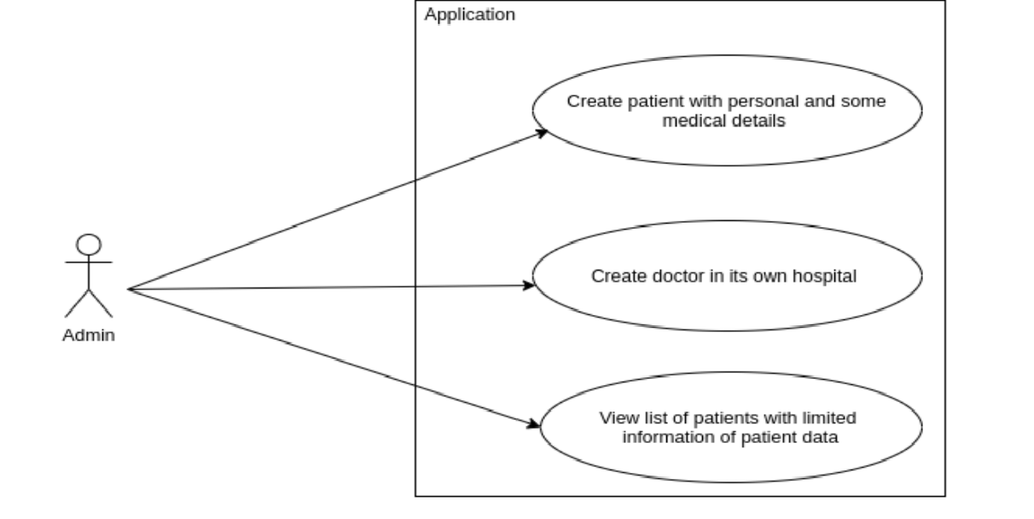
Use Cases
There are three users in the system with role admin, patient, and doctor. Each user has its own use cases. A user interfaces for admin from every hospital to make necessary changes about users.
Admin

Slide 8
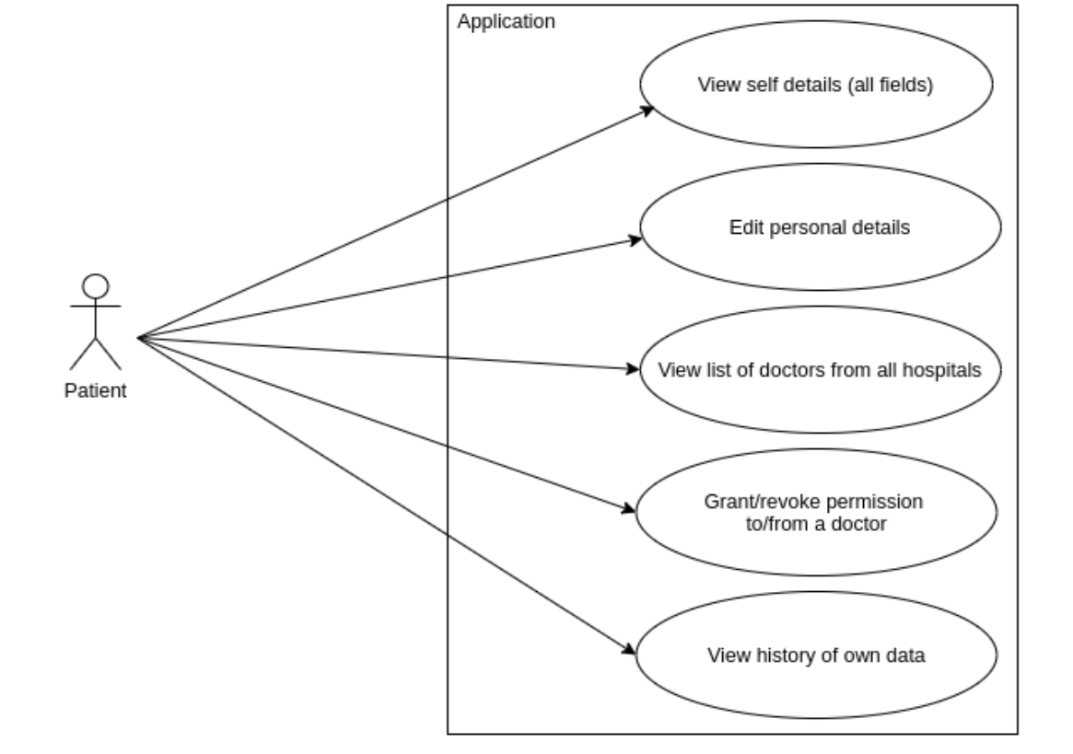
Patient

Slide 9
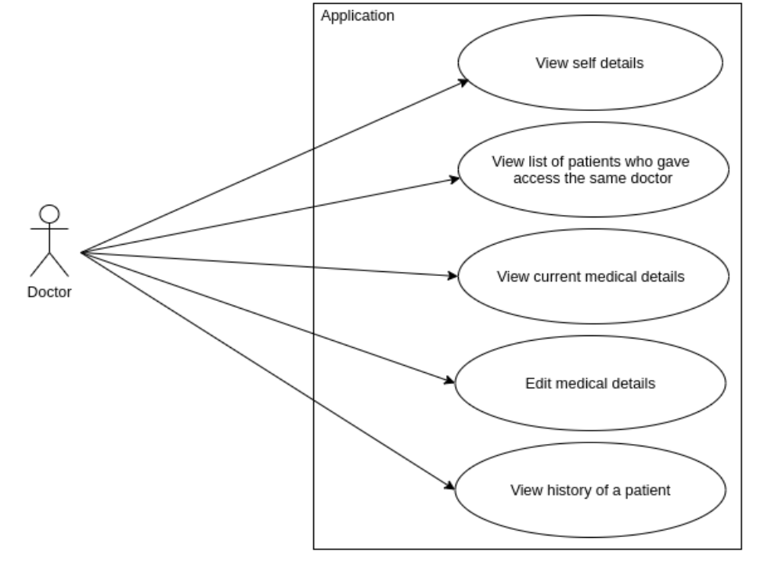
Doctor

Slide 10
Architecture
The patient needs to create an account only the first time the patient visits any one of the hospitals in the network, during the first visit the patient provides details to the admin, admin invokes the AdminContract to create a patient.
In the backend, firstly the admin certificate is used to connect to the network, and a transaction is created which adds the patient object to the ledger and also adds the patient identity to the blockchain network.
After the creation of the patient is successful, the server creates a temporary password for the patient using which the patient can log in to the network.
The patient credentials are added to the ledger as the patient can go to any of the hospitals in the network.

Slide 11
The interaction to create a doctor. The doctor provides details to the admin, who then firstly connects to the network and then adds the doctor as an identity to the blockchain network.
And the credentials of the doctor are stored in the hospital-specific Redis database. Now as patient and doctor are added as identities in the blockchain network, for the next interaction the patient/doctor can connect to the network using their certificates.

Slide 12
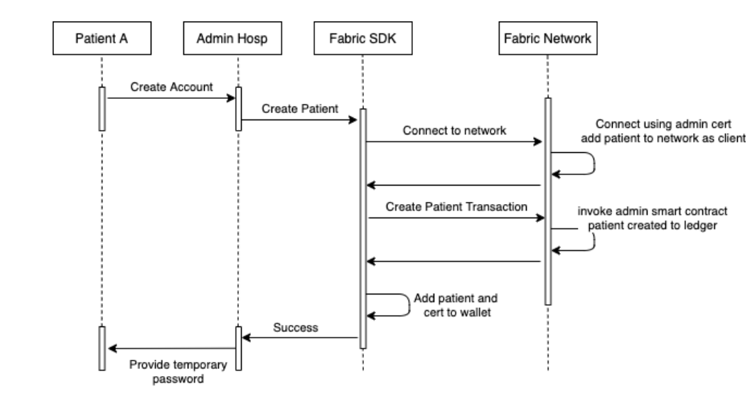
Diagram

Slide 13
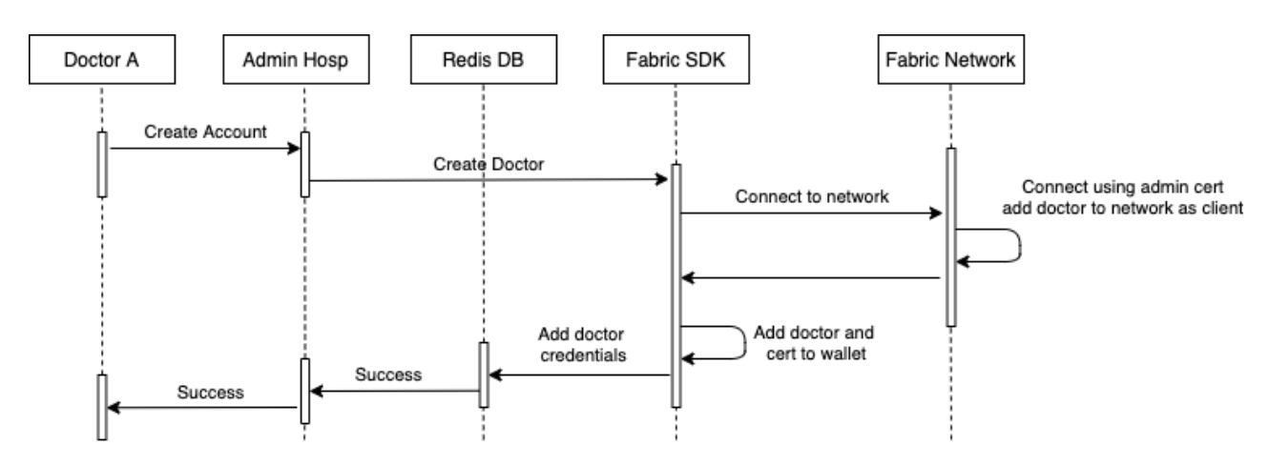
Doctor

Slide 14
Similarly there are other modules such as Ambulance, Billing,Prescription of the patient and laboratory. This module are available for every hospital and change the details.
The patients can book the doctor and the doctor can accpect the booking if the doctor is available in the given slot.

Slide 15
THANK YOU

